Slide 1
Electricity

Slide 2
U.S. electricity generation and share from selected fuels and renewable sources

Slide 3
U.S. electricity demand
Note: Onsite generation is electricity produced onsite for own use.

Slide 4
U.S. electricity generation levels from selected fuels and renewable sources
U.S. electricity generation, AEO2021 oil and gas supply cases
Note: Renewables category includes electricity generation from wind, solar, hydroelectric, geothermal, wood, and other biomass sources.

Slide 5
U.S. electricity generation levels from selected fuels and renewable sources
U.S. electricity generation, AEO2021 renewables cost cases
Note: Renewables category includes electricity generation from wind, solar, hydroelectric, geothermal, wood, and other biomass sources.

Slide 6
U.S. retiring and new generating capacity
Annual electricity generating capacity additions and retirements
AEO2021 Reference case
gigawatts
Source: Form EIA-860M, Monthly Update to the Annual Electric Generator Report, July 2020

Slide 7
U.S. cumulative retiring and new generating capacity

Slide 8
Electricity prices by components and long-term average electricity prices

Slide 9
Hybrid versus stand-alone solar photovoltaic (PV) and energy storage systems
U.S. solar PV generating capacity, all sectors
AEO2021 Reference case
gigawatts
U.S. storage energy capacity, power sector
AEO2021 Reference case
billion kilowatthours

Slide 10
Renewable capacity by source and region

Slide 11
Economic cost competitiveness of generating technologies
Levelized avoided cost of electricity (LACE) and levelized cost of electricity (LCOE) by technology,
2026 online year, AEO2021 Reference case
2020 dollars per megawatthour
regions with built capacity
regions with no built capacity
levelized avoided cost of electricity
Economically attractive builds are shown above the diagonal breakeven line for each technology.
The solid, colored circles on the figure indicate that projects tend to be built in regions where revenue (LACE) exceeds costs (LCOE)
levelized cost of electricity
Note: CCGT = natural gas combined cycle, PV = solar photovoltaic

Slide 12
U.S. renewable portfolio standards
Total qualifying renewables generation required for combined state renewable portfolio standards and projected total generation from compliant technologies
AEO2021 Reference case
billion kilowatthours

Slide 13
U.S. nuclear capacity and annual capacity changes
U.S. nuclear electricity generating capacity
AEO2021 oil and gas supply cases
gigawatts
Year-over-year nuclear capacity changes
AEO2021 Reference case
gigawatts

Slide 14
U.S. coal-fired generation, capacity, and capacity factors

Slide 15
U.S. coal-fired generating capacity relative to natural gas prices
U.S. electric generating capacity
AEO2021 oil and gas supply cases
gigawatts
Average delivered natural gas prices to the electric power sector
2020 dollars per million British thermal units

Slide 16
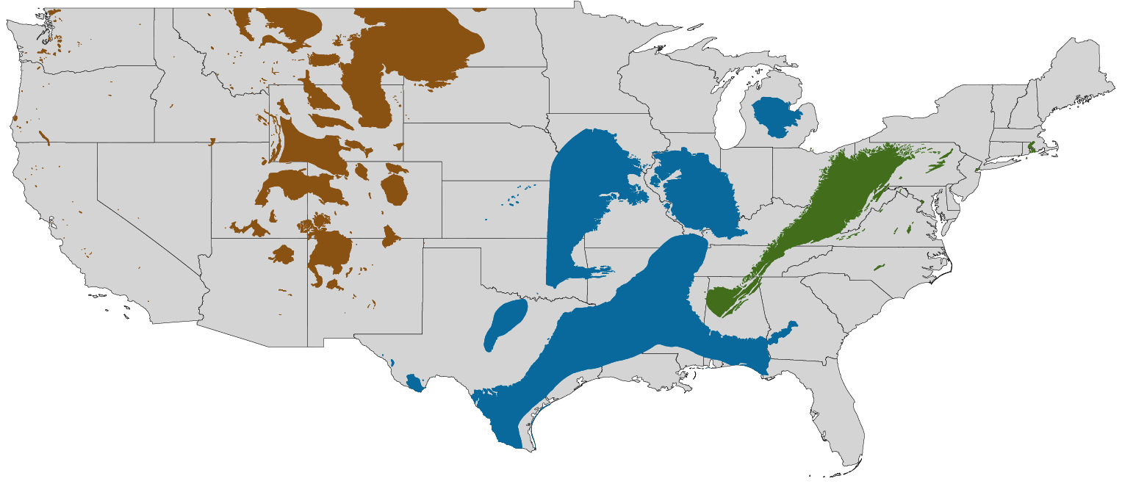
Coal production by U.S. region
U.S. coal production by region, AEO2021 oil and gas supply cases
Reference case
million short tons
Low Oil and Gas Supply case
million short tons
High Oil and Gas Supply case
million short tons
2020
projections
2020
projections
total
West
Appalachia
Interior

Slide 17
U.S. fossil fuel-fired plant capacity factors
Capacity factor for U.S. fossil fuel-fired plants
AEO2021 Reference case
percentage
Note: New combined-cycle (natural gas) plants are assumed to come online in 2023. New builds as shown are multi-shaft combined-cycle units. Existing combined cycle units include both multi-shaft and single-shaft; 12 gigawatts of new single-shaft combined-cycle units are included in existing.

